Slide 1
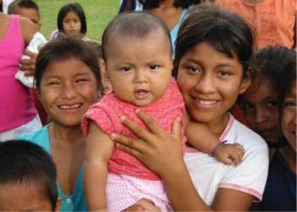
Bayanan kiwon lafiyan yara
don kowa da kowa
© 2002 Virginia Lamprecht, Courtesy of Photoshare
Hafsat Rufai Ahmad CHIFA Country Representative, Nigeria
GABATARWAR CHIFA A YAREN HAUSA

Slide 2
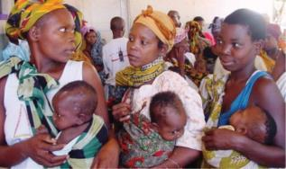
Girman matsalar
‘’kimanin yara miliyan 5.9 yan kasa da shekaru 5 suka mutu a cikin shekara ta 2015. Fiye da rabin wannan adadi sun mutu ne a sanadiyyar cuttutuka wadanda suke da matakan rigakafi ko kuma ake iya magance su ta hanyoyi masu sauki.’’
World Health Organization,
January, 2016
© 2003 Arturo Sanabria, Courtesy of Photoshare

Slide 3
Manufar CHIFA
Burin CHIFA shine samar wa duniya yanayi inda duk wani ma’aikacin/ jami’in lafiya, iyaye da kowane yaro zai samu bayanin kiwon lafiya da suke bukata don kare lafiyarsu da lafiyar ya’ yan da ke karkashin kulawar su

Slide 4
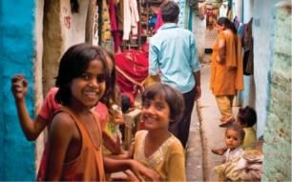
Menene CHIFA?
Gangami da ya game duniya
Kungiyar sadarwa ta kwararru
Dandalin tattaunawa
Da yake amsa bukatu na neman karin bayani da fahimta ga wadanda alhakin kula da yaran dake kasashe masu karamin karfi/ matalauta suke
Manufar CHIFA ta kunshi maida hankali kan hakkokin yara na tabbatar da lafiyarsu, kiwon lafiyarsu da kuma muamalolin dake shafar lafiya.
© 2010 Rupal Shah, Courtesy of Photoshare

Slide 5
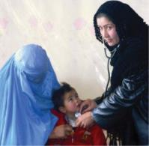
Mambobin CHIFA
Daga cikin ya’ yan kungiyar CHIFA dubu uku sun hada da:
Jamian kula da lafiyar yara
Masu fada aji
Masu binciken kimiyya
Masu rubuce rubuce/ Mawallafa
Jamian yada labaru
A kasashe 140 na duniya
© 2005 Ben Barber, Courtesy of Photoshare

Slide 6
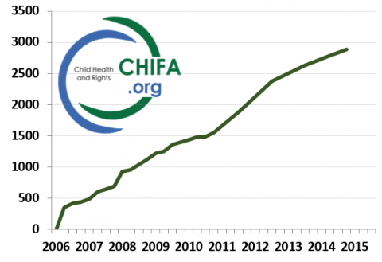
Yawan ya’yan kungiyar CHIFA

Slide 7
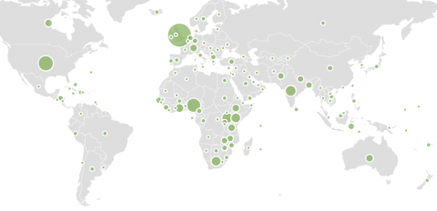
Wuraren da za a iya samun
Ya’yan kungiyar CHIFA a duniya

Slide 8
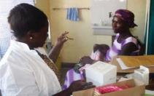
Menene fa’idar shiga
wannan kungiya?
Kasancewa daya daga cikin gamammiyar alumma mai ya’yan kungiya fiye da dubu uku daga kasashe dari da arbin (140) na duniya
Samun bayanai game da hanyoyin samun kudaden bincike na kimiyya da damar kwasa-kwasan musayar ilmi/ guraban kara inganta ilmi , shafukan yanar gizo masu amfani da kuma sababbin makaloli/ mujallu a kan harkar lafiyar yara
Ya da muradun/ manufofin kungiyar ku da ayyukanta
Musanyar ilmi da fahimtar juna
Samun sababbin abokan hulda
Amfani da hanyoyin hada kai domin cimma burin da aka sa a gaba.
© 2007 Julius Ayuure, Courtesy of Photoshare

Slide 9
Me ya’yan kungiyar CHIFA suke cewa game da kungiyar?
“na karu matuka daga bayanan da ake turo mani.”
Isaac E Ocheke,
Kwararren likitan yara
Jos University Teaching
Hospital, Nigeria
“irin wannan kungiya da dandalin tattaunawa na da matukar muhimmanci.”
Jonathan Spector,
Doctors without Borders
”CHIFA wani gagarumin dandali ne da ke hada kan jamian lafiya cikin sauri […] abu ne mai sauki a fahimtar da malaman lafiya bayanai gamsassu kamar akan sahihiyar hanyar kiwon lafiya, e.g. on quality of care, obesity, child development. I still keep using CHIFA, and its stimulating discussions.”
Dr. Elizabeth Mason, Former Director of WHO’s Department of Maternal, Newborn, Child and Adolescent Health

Slide 10
CHIFA na daya daga cikin kungiyoyin
HIFA guda biyar

Slide 11
Domin Kasancewa cikin wannan kyakkyawar tattaunawa ta hanyar shiga kungiyar a kyauta, jeka wannan shafin yanar gizo: www.chifa.org
Mun gode!

