Slide 1

HIFA Country Representatives Programme
Tara Ballav Adhikari
Country Representative Coordinator

Slide 2
Main Objectives
HIFA Country Representatives are volunteers who are committed to help achieve the HIFA vision in their country. They are critically important in :
Raising awareness about the importance of access to healthcare knowledge.
Engaging new members in their country to join HIFA.

Slide 3
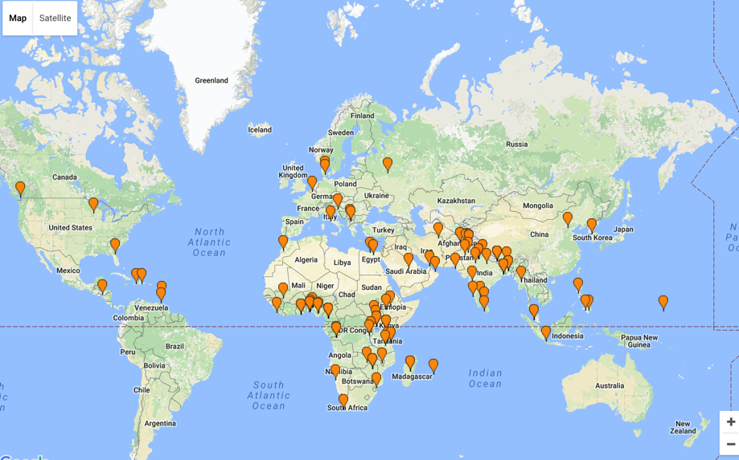
Current Status
137 Country Representatives in 71 countries.
Since March 2016, when I became CRC, we have 10 new CRs plus 3 more in the pipeline.

Slide 4
Distribution of Country Representatives

Slide 5


Two examples of special activities by CRs to promote HIFA
Didier Demassosso, HIFA CR for Cameroon, 9-10 May 2016
Jackeline Alger, HIFA CR for Honduras, 16-19 August 2016

Slide 6
Country Representatives are important to help achieve the
HIFA Strategic Objectives 2016-18
1. Growth and multilingualism
>20,000 members interacting in 5 languages
>300 Country Representatives in 90 countries
Multilingual HIFA Voices database
2. Collaboration and cooperation
>400 HIFA Supporting Organisations
International recognition as transformative approach to bring stakeholders together to address complex global health challenges

Slide 7
How can we increase the number of Country Representatives to 300 by 2018?
Raise visibility and activity of existing CRs
Invite HIFA members to become CRs via general invitation and via targeted invitation
Use social media to spread the word!
We welcome other ideas…

Slide 8

Thank you Deborah Jackson (Former HIFA Country Representative Coordinator) and Dr. Neil Pakenham-Walsh

Slide 9
Thank you ☺

Slide 10
HIFA Country Representatives Program
Tara Ballav Adhikari
Country Representative Coordinator

